Slide 1
Design and Analysis of Algorithms
Introduction(Ch1)
Software School
ZhangLiyong

Slide 2
Contact us
张立勇
  zhangliyong@xidian.edu.cn
  88204613
邓凡
  dfmyfavorites@126.com
  13759995594

Slide 3
Topics
Basic Concepts
Asymptotic Analysis

Slide 4
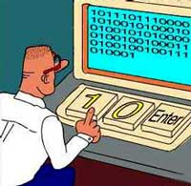











Factors of Programming
Programming Languages？
BASIC
PASCAL
C
程序设计语言
C#
IDE?

Slide 5
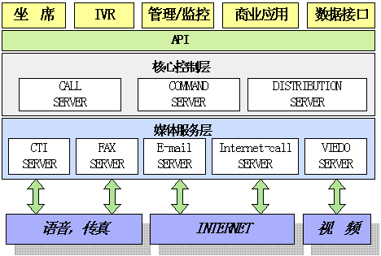
What is more important?
Software Architecture
Notes:
体系结构是一个骨架（skeleton），系统的特性（properties）围绕这个骨架增加（flesh out），因此体系结构在表达系统满足总需求（gross requirements）的能力方面起至关重要的作用。
局部设计或实现上有缺陷，可能最终的软件系统还是可以接受的，而体系结构的设计上一旦出现失误，那后果就极有可能是致命的。就像我们日常生活中的经验一样，任何完整的东西，整体架构都是十分关键的，对于程序/软件来说也不例外。
尤其是现在的软件系统变得规模越来越大，越来越复杂。现在几十万行、甚至上百万行源代码的软件都很常见，体系结构的重要性就越来越突出了。

Slide 6
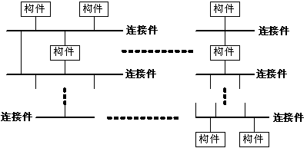
Software Architecture
Software Architecture Style
C2 Style
Notes:
好，我们知道了体系结构很重要，那么就应该重视，怎么重视呢？首先，我们要学习别人的成功经验。在软件领域，经验（包括别人的和自己的）很重要，因为这个领域的理论还没有足够成熟到让我们没有经验就可以做得很好。
我的老板有一句名言：软件开发要先学着用别人的牙刷刷牙。听起来有点恶心，就是说尽管看、学习别人的东西很难受，但是很难避免。
回到软件体系结构，我们关注体系结构，首先要学习别人在已有的系统中已经被实践证明了是比较成功的体系结构范例，就是体系结构Style或者叫pattern。当然，学习Style的目的是为了能够应用到类似的实际系统中。
这里我们简单看几中典型的体系结构模式。
这是C2体系结构的示意图。
C2体系结构风格可以概括为：通过连接件绑定在一起的按照一组规则运作的并行构件网络。
（1）系统中的构件可实现应用需求，并能将任意复杂度的功能封装在一起；
（2）所有构件之间的通讯是通过以连接件为中介的异步消息交换机制来实现的；
（3）构件相对独立，构件之间依赖性较少。系统中不存在某些构件将在同一地址空间内执行，或某些构件共享特定控制线程之类的相关性假设。

Slide 7
Software Architecture
Software Architecture Style
#include <iostream>
using namespace std;
int main () {
int a,b;
while(cin >> a >> b)
cout << a+b << endl;
}
Filters
int while ( ) >> << + ; { }
main a b cin cout endl
……
Function(main)
Declaration;
while structure(condition)
expression
Pipes
*.o
Pipe-Filter Style
*.exe
Notes:
管道/过滤器风格的示意图。一个著名的例子是传统的编译器。传统的编译器一直被认为是一种管道系统，在该系统中，一个阶段（包括词法分析、语法分析、语义分析和代码生成）的输出是另一个阶段的输入。
管道/过滤器风格的软件体系结构具有许多很好的特点：
（1）使得软构件具有良好的隐蔽性和高内聚、低耦合的特点；
（2）允许设计者将整个系统的输入/输出行为看成是多个过滤器的行为的简单合成；
（3）支持软件重用。重要提供适合在两个过滤器之间传送的数据，任何两个过滤器都可被连接起来；
（4）系统维护和增强系统性能简单。新的过滤器可以添加到现有系统中来；旧的可以被改进的过滤器替换掉；
（5）允许对一些如吞吐量、死锁等属性的分析；
（6）支持并行执行。每个过滤器是作为一个单独的任务完成，因此可与其它任务并行执行。
举A+B例子的编译过程示例。

Slide 8
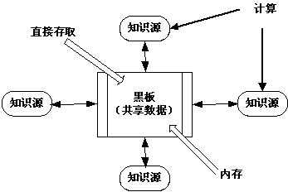
Software Architecture
Software Architecture Style
Repositories Style
Notes:
在仓库风格中，有两种不同的构件：中央数据结构说明当前状态，独立构件在中央数据存贮上执行，仓库与外构件间的相互作用在系统中会有大的变化。
控制原则的选取产生两个主要的子类。若输入流中某类时间触发进程执行的选择，则仓库是一传统型数据库；另一方面，若中央数据结构的当前状态触发进程执行的选择，则仓库是一黑板系统。
图4是黑板系统的组成。黑板系统的传统应用是信号处理领域，如语音和模式识别。另一应用是松耦合代理数据共享存取。
我们从图4中可以看出，黑板系统主要由三部分组成：
（1）知识源。知识源中包含独立的、与应用程序相关的知识，知识源之间不直接进行通讯，它们之间的交互只通过黑板来完成。
（2）黑板数据结构。黑板数据是按照与应用程序相关的层次来组织的解决问题的数据，知识源通过不断地改变黑板数据来解决问题。
（3）控制。控制完全由黑板的状态驱动，黑板状态的改变决定使用的特定知识。

Slide 9
Software Architecture
Other styles：
  event based，or implicit invocation
  process control
  interpreter
  layered systems
  distributed processes
  main program/subroutine organizations
  state transition systems
  other dssa

Slide 10
Software Architecture
Software Architecture——J2EE
Applet Container
HTTP
SSL
Applet
Web Container
EJB Container
EIS
(SAP)
J2SE
Servlet
JSP
Enterprise
Bean
Application Client
Container
JTA
JMS
JNDI
Java
Mail
RMI/IIOP
JDBC
JCA
JTA
JMS
JNDI
Java
Mail
RMI/IIOP
JDBC
JCA
EIS
(CICS)
Application
Client
HTTP
SSL
JAF
JAF
JMS
JNDI
RMI/IIOP
JDBC
J2SE
J2SE
Database
RMI/IIOP
J2SE
Client Tier
Middle Tier
EIS Tier

Slide 11
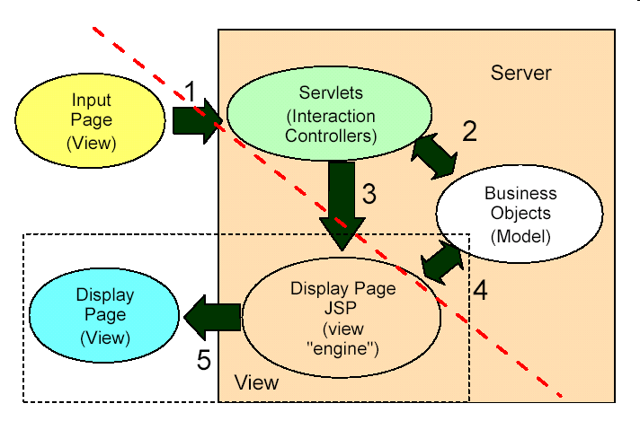
Software Architecture
Software Architecture——J2EE

Slide 12
Software Architecture
Software Architecture——CORBA
Application Interface
Domain Interface
CORBA Facilities
Object Request Broker
CORBA Services

Slide 13
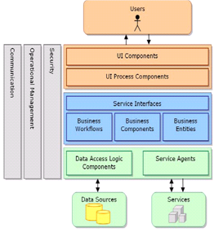
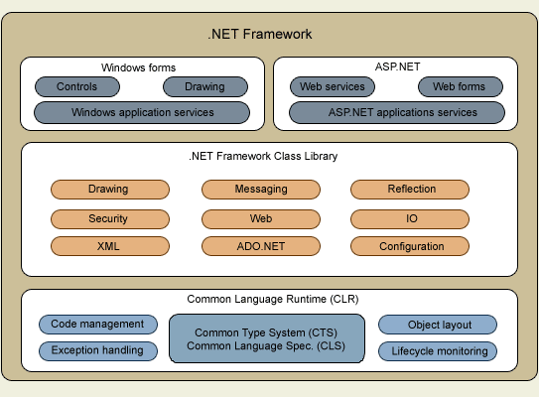
Software Architecture
Software Architecture——.NET

Slide 14
Software Architecture
Software Architecture——Web Service
UDDI
Registry
Service
Broker
Publish/UDDI
/WSDL
Find/UDDI
/WSDL
Service
Provider
Bind/Invoke
Service
Requester
Web
Service
Client
Application
SOAP

Slide 15
What is more important?
?How can we assemble a software system more than to develop one
System Services
Application Interface
Domain Interface
CORBA Facilities
Object Request Broker
CORBA Services

Slide 16
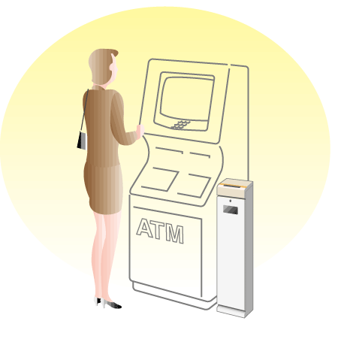
System Services
Transaction
  Finish all or none

Slide 17

System Services
Security
  Who r u?
  What do u want?

Slide 18
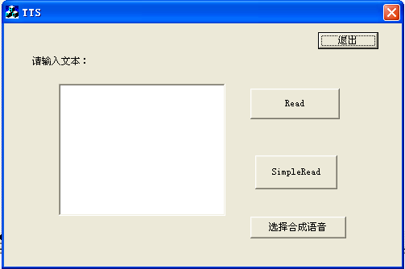
Using Components

Slide 19
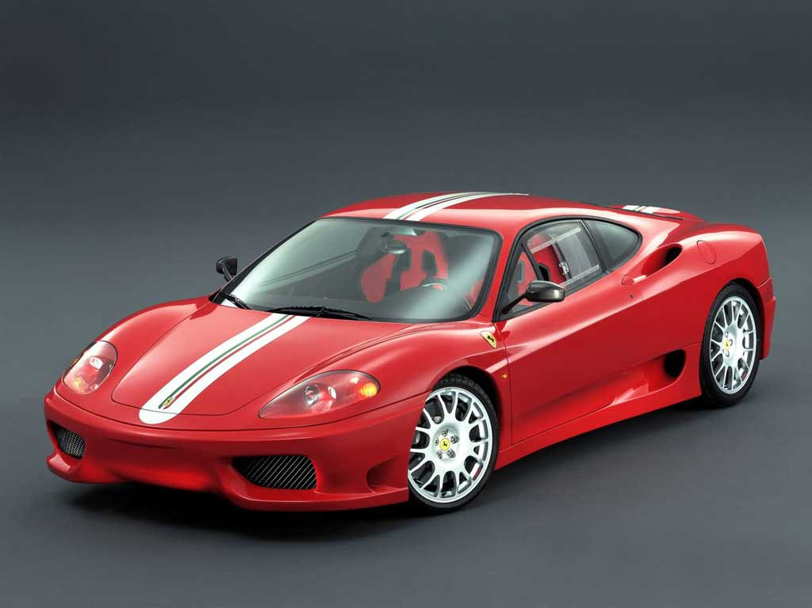
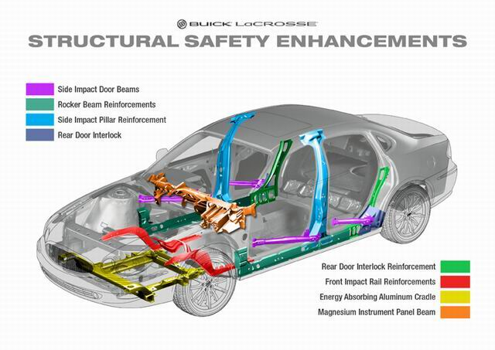

What’s more after framework?
DS and Algorithm

Slide 20
Algorithms
Algorithm ?= Program
Algorithm. (webster.com)
--A well-defined computational procedure that takes some value, or set of values, as input and produces some value, or set of values, as output.
--Broadly: a step-step procedure for solving a problem or accomplishing some end especially by a computer.
Input
Algorithm
Output
--issues: correctness, efficiency (amount of work done and space used), storage (simplicity, clarity), optimality .etc.

Slide 21
What kind of problems
Human Genome Project
  100,000 genes，sequences of the 3 billion chemical base pairs
Internet
  Finding good routes on which the data will travel
  Search engine
Electronic commerce
  Public-key cryptography and digital signatures
Manufacturing
  Allocate scarce resources in the most beneficial way
Notes:
基因工程的目标之一就是识别出人类DNA中所有的10万个基因，确定构成人类DNA的30亿化学碱基对序列。

Slide 22
A concrete problem
Problem: you are given n integers(there may be negative ones but not all) a₁,a₂,…,a_{n}, determine i and j which maximize the sum from a_{i} to a_{j .}
Case: 6 integers: (-2，11，-4，13，-5，-2)
Ans: i=2,j=4, max sum is 20.

Slide 23
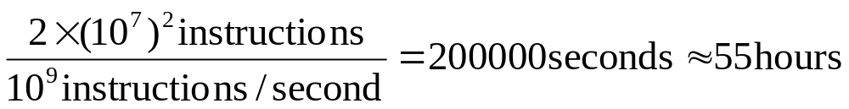
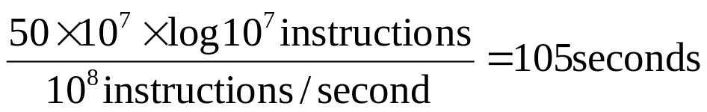
Importance of algorithms
Problem: sorting 10,000,000 integers
  Case 1: Computer A executes one billion instructions per second(1GHz), an algorithm taking time roughly equal to 2n² to sort n integers.
  Case 2: Computer B executes one hundred million instructions per second(100MHz), an algorithm taking time roughly equal to 50nlgn to sort n integers.
  Case 1:
  Case 2:

Slide 24
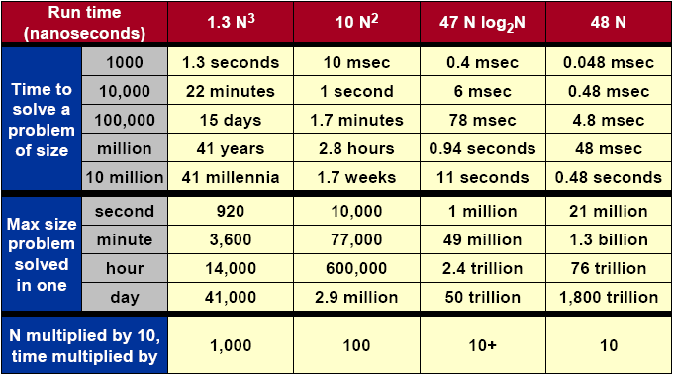
Importance of algorithms

Slide 25
About the Course
Design and Analysis
  How can I propose an algorithm for a specific problem?
  Is the algorithm good enough?
Design
Analysis
D
&
C
Greedy
D
P
…
B
a
s
i
c
s
C
a
s
e
s
M
S
Q
S
…
A
S
P
H
u
f
f
m
a
n
…
A
L
S
M
C
M
…
H
S
…

Slide 26
结束
2009年8月18日

Slide 27
Analysis of algorithms
The theoretical study of computer-program performance and resource usage.
what’s more important than performance?
--modularity --user-friendliness
--correctness --programmer time
--maintainability --simplicity
--functionality --extensibility
--robustness --reliability

Slide 28
Why study algorithm and performance?
Algorithms help us to understand scalability.
Performance often draws the line between what is feasible and what is impossible.
Algorithmic mathematics provides a language for talking about program behavior.
The lessons of program performance generalize to other computing resource.
Speed is fun.
Notes:
Scalability：可量测性

Slide 29
The problem of sorting
Input: sequence <a₁,a₂,…,a_{n}> of n natural numbers
Output: permutation <a’₁,a’₂,…,a’_{n}> such that a’₁≤a’₂≤…≤a’_{n}
Example
--Input: <5,2,4,6,1,3>
--Output: <1,2,3,4,5,6>

Slide 30
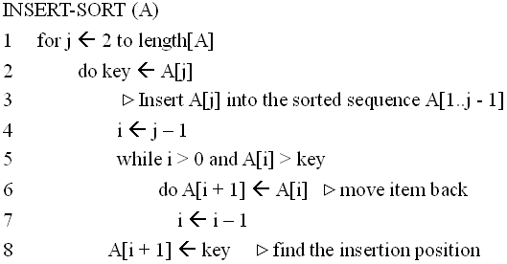
Insertion Sort
1
i
j
n
sorted
key

Slide 31
Insertion Sort
初始
j=2
j=3
1
2
3
4
5
6
1
2
3
4
5
6
1
2
3
4
5
6
-∞
8
5
7
9
6
4
-∞
8
5
7
9
6
4
-∞
5
8
7
9
6
4
j=4
j=5
j=6
1
2
3
4
5
6
1
2
3
4
5
6
1
2
3
4
5
6
-∞
5
7
8
9
6
4
-∞
5
7
8
9
6
4
-∞
5
6
7
8
9
4

Slide 32
Running time
The running time depends on the input: an already sorted sequence is easier to sort.
Parameterize the running time by the size of the input, since short sequences are easier to sort than long ones.
Generally, we seek upper bounds on the running time, because everybody likes a guarantee.

Slide 33
Kinds of analysis
Worst-case: (usually)
--T(n) = maximum time of algorithm on any input of size n.
Average-case: (sometimes)
--T(n) = expected time of algorithm over all inputs of size n.
--Need assumption of statistics distribution of inputs.
Best-case: (bogus)
--Cheat with a slow algorithm that works fast on some input.
Notes:
Bogus：假的, 伪造的

Slide 34
Machine-independent time
What is insertion sort’s worst-case time?
--It depends on the speed of our computer:
>>relative speed (on the same machine)
>>absolute speed (on different machine)
BIG IDEA:
--Ignore machine-dependent constants.
--Look at growth of T(n) as n → ∞
“Asymptotic Analysis”

Slide 35
Θ--notation
Math:
Θ(g(n)) = {f(n): There exist positive constants c₁, c₂, and n₀ > 0 such that 0≤c₁g(n) ≤f(n)≤c₂g(n) for all n≥n₀}
Engineering:
--Drop low-order terms; ignore leading constants.
--Example: 3n³ + 90n² – 5n + 6046 = Θ(n³)

Slide 36
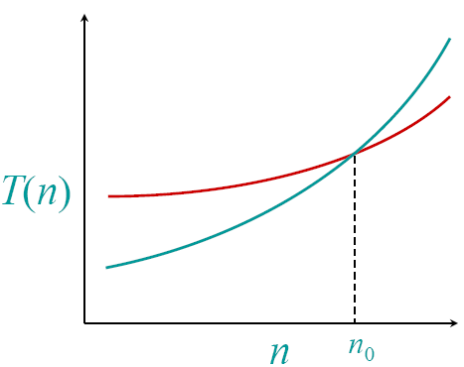
Asymptotic performance
When n gets larger enough, a Θ(n²) algorithm always beats a Θ(n³) algorithm
-- We shouldn’t ignore asymptotically slower algorithms, however.
-- Real-world design situations often call for a careful balancing of engineering objectives.
-- Asymptotic analysis is a useful tool to help to structure our thinking.

Slide 37
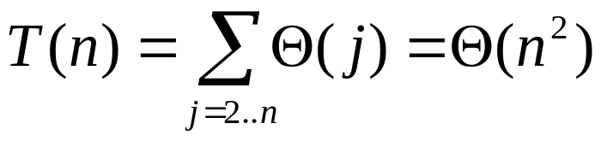
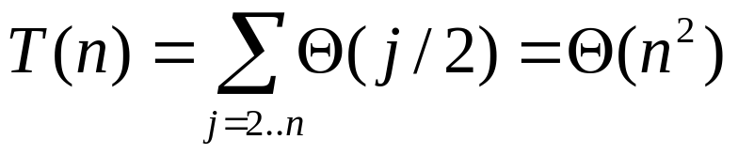
Insertion sort analysis
Worst case: Input reverse sorted
Average case: All permutations equally likely
Is insertion sort a fast sorting algorithm?
--Moderately so, for small n.
--Not at all, for large n.

